Slide 1
India Equity Outlook
"Being fearful while others are reckless and being a little venturesome when others are fearful is an oft repeated advice to succeed in the equity markets."
— CMA CA Dhiraj Sachdev

Slide 2
Current Global Equity Environment
US Tariffs & Trade Frictions
Immigration & H1B Policy
Escalating tariffs pressuring global trade flows; India faces extra penalty duties in select categories
Stricter US stance on work visas adds uncertainty for Indian IT/services exports
Geopolitical Tensions
Dollar Dynamics
Middle East conflicts, US–China rivalry, Russia–Ukraine war keep risk premium elevated
DXY showing USD weakness vs global basket, but INR depreciates due to FII outflows, CAD
Supply Chain Realignment
Global Growth Concerns
China+1 strategy creating opportunities for India but margin pressures in transition
IMF/WB lowering forecasts; uneven recovery weighing on investor sentiment
Liquidity & Flows:
Central bank policies (Fed/ECB/BoJ) impacting global risk appetite; FPI flows remain volatile for emerging markets.

Slide 3



India's Counter-Measures & Reform Push
Income Tax Relief
Monetary Easing
Fiscal Policy Tilt
No tax up to ₹12 lakh
Repo rate cut: 100 bps (6.5% → 5.5%)
Front-loading infra & capex spending
Standard deduction: ₹75,000
₹5.6 lakh crore liquidity injected
GST cut to spur demand
Early Demand Indicators
Structural & Institutional Reforms
Earnings Growth Outlook
2-wheeler volumes: +20% YoY (Q1 FY26)
Manufacturing & infra reforms under way.New Pay Commission (FY26) to lift disposable incomes.
Consumption boost + lower rates + infra push → stronger earnings trajectory
Car/SUV sales rising
Corporate deleveraging & margin support
Trichy market: +40% post GST cut

Slide 4
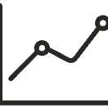




Ownership & Valuations
Premium Valuations Justified
Pockets of Expensiveness
India's higher GDP growth & superior ROE vs developed markets → valuation premium sustainable
Some mid/small-cap names stretched
IPO pricing aggressive in recent issues — selective caution needed
Earnings cycle on upswing, supporting multiples
Flows & Market Participation
Changing Market Structure
FIIs: net sellers in secondary, buyers in QIPs & PE
Indian equity increasingly driven by domestic liquidity.Broader ownership base reducing vulnerability to FII outflows.
Domestic MFs: consistent SIP inflows
Retail/Households: now own more equity than FIIs
Equity Penetration Still Low: Retail participation <10% of household savings in equities → significant headroom for growth

Slide 5
Where to Invest
Selective — Bottom-Up & Company Specific
Auto / Ancillary
2-wh/PV/CV/Tractors & auto parts — under-penetration, new emission norms, EV, replacement demand
Banks/NBFCs
Franchise business in capital-starved economy
New Age Tech
Operating leverage, path to profitability — food delivery, fintech, e-commerce, retail services
Engineering / Capital Goods
Cusp of manufacturing cycle
Consumer
Appliances, durables, jewellery, value fashion — under-penetration, credit, better monsoon, tax & GST cuts
Cement / Building Products / Real Estate
Housing & infra demand — residential, commercial, co-working spaces

Slide 6
More Investment Opportunities
Specialty Chemicals / Pharma
IT Services
EMS — Electronic Manufacturing
Niche chemistry skills, generics/APIs, formulations
Growth challenges from AI, higher H1B costs — entering value zone
Mobile, IT hardware, PCBs — large opportunity, valuations ahead
Entertainment
Transportation Services
Defense & Renewables
Music sector opportunities
Aviation sector growth
Strategic growth sectors
Healthcare
Metals & Mining
Futuristic
Hospitals, diagnostics, specialized clinics — valuations ahead of time
Cyclical — ferrous/non-ferrous, expanding capacities, backward integrated
Semiconductors, deep tech, space tech, biologics

Slide 7




Behavioral Perspective
Stages of Bull Market — What Stage Are We In?
Born
After bear market when everyone's convinced things can only get worse
Pessimism
Grow
Few people begin to believe things will get better
Skepticism
Mature
Most investors realize improvement is taking place
Optimism
Die
Everyone concludes things will remain better forever
Euphoria
"What the wise man does in the beginning, the fool does in the end"
— Old Adage

Slide 8

Equity Principles
Specific to Current Environment
Value Investing
Economic Cycles
Psychology Matters Most
Buy below intrinsic value, sell higher — foundation for steady, unemotional, profitable investing
Markets cycle up & down — extrapolation risk can be dangerous
More important than accounting or economics
Herd Behavior
Pendulum Awareness
Trends Become Overdone
Psychology of herd causes market extremes — popularity contest vs. pay-offs as contrarian
Euphoria to depression, overpriced to underpriced — extreme behavior reverses, creating temporary opportunity windows
Most bullish/bearish trends eventually become overdone
Perceived vs. Real Risk
Timing is Futile
Pessimism = Maximum Return
Evaluate pay-offs — risk/return balance
Time in the market more important than timing the market
Aggression in panicky environment
Another fearful event, another bargain opportunity — time to invest

Slide 9
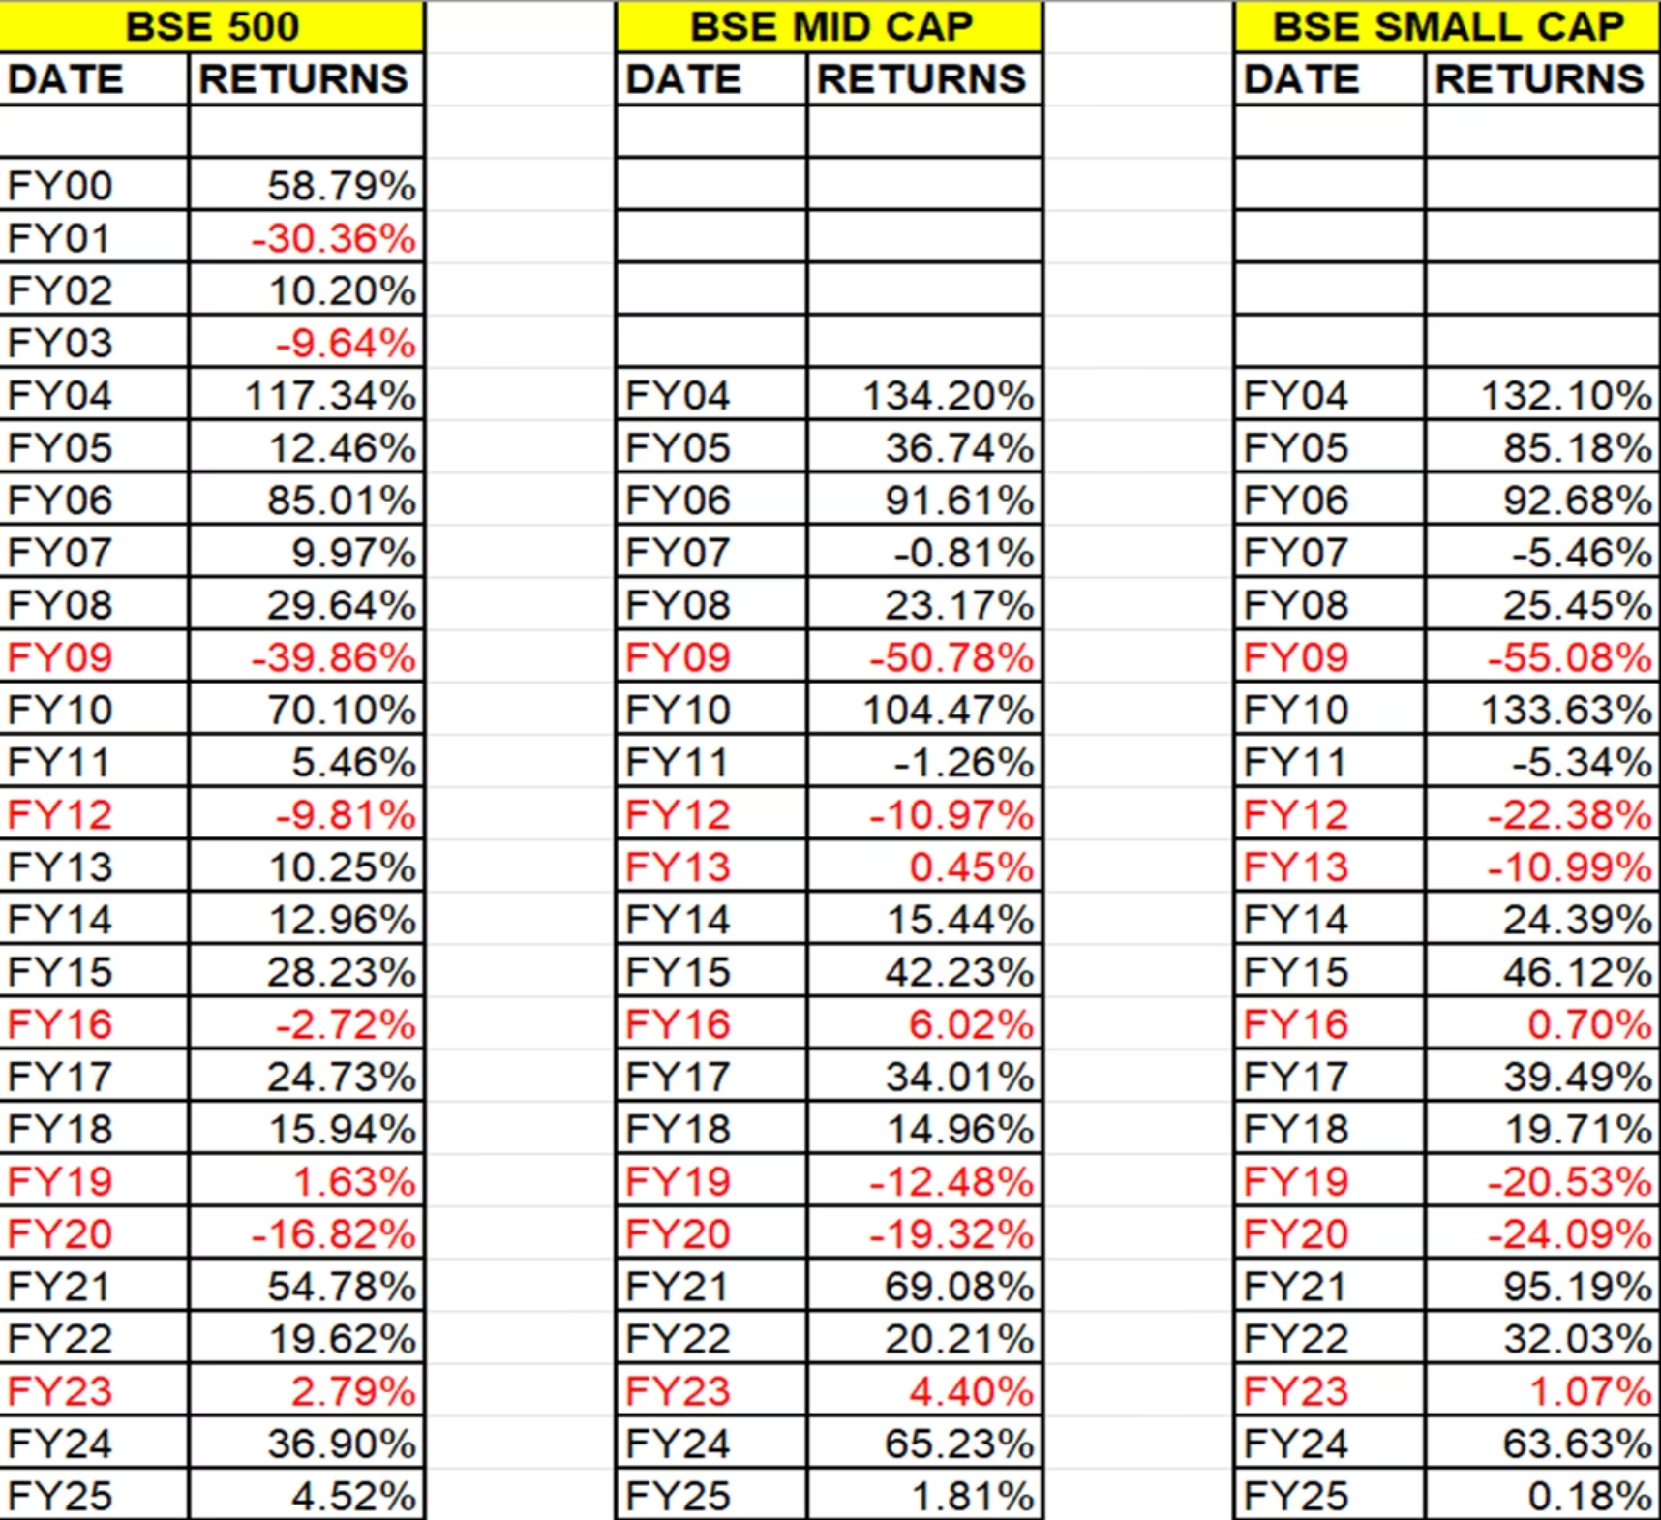
Lessons From History
Previous year and Prospective Returns
Historical data shows cyclical patterns: periods of strong growth followed by corrections, then recovery. Mid & small caps offer higher growth potential with greater volatility.

Slide 10
Final Outlook
Structural Story Intact
Corporate Earnings Cycle
Flows & Ownership
Demographics, domestic consumption, digital adoption, manufacturing push underpin long-term compounding potential
12–15% CAGR over medium term with small & mid-caps offering better growth prospects selectively
Domestic investors increasingly offsetting global flows; India's equity culture deepening
Valuations
Premium to EM peers justified by RoE/earnings visibility, but dispersion within sectors is high – stock selection critical.
Near-Term Headwinds
Strategy
Tariff-led volatility
Stay invested. Focus on quality franchises, earnings visibility, cash-flow generation
Global risk-off flows/slowdown
Avoid momentum-driven pockets
Rich valuations in select mid/small caps
Currency weakness
Work with professional fund managers
"Short-term volatility is inevitable, but India's structural growth drivers provide one of the most compelling equity opportunities in global markets for wealth creation."
Correction & subdued phases present opportunities in disguise.
Thank You

