Slide 1



International Financial Services Centre in GIFT City:
GIFT IFSC-Gateway to global finance
2025
International Financial Services Centre Authority
Ministry of Finance, Government of India
GIFT City, Gujarat, India
www.ifsca.gov.in

Slide 2

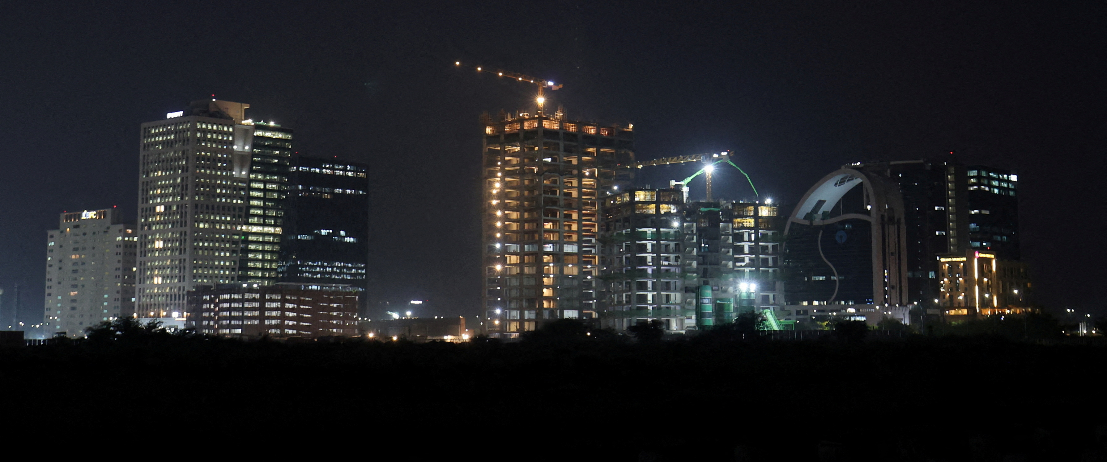
GIFT City and IFSC Opportunity

Slide 3
GIFT IFSC Journey so far
The latest Global Financial Centers Index, London Report (March 2025) ranks IFSC in GIFT City at 46th Position among 119 Centres
IFSC Authority Act, 2019 passed by Union Parliament
IFSCA notified 30+ Regulations and granted 1000 + Registrations
1st Commercial building inaugurated at GIFT City
Jan. 2013
April 2015
Dec. 2019
Oct. 2020
August 2025
India’s 1st IFSC became operational with regulations from RBI, SEBI and IRDAI
IFSCA assumes power to develop and regulate GIFT IFSC from 1st Oct 2020

Slide 4
GIFT City and IFSC
India's 1st Operational Smart City & IFSC
29 Mn Sq ft
38
24
Total development
rights allotted
Number of Under Construction Building
Number of Operational Buildings
GIFT City is divided into two zones:
  Special Economic Zone (IFSC Zone)
  Domestic Tariff Area (Domestic area)
Greenfield Smart city
Land parcel size: 886 acres
Social Infra – Hotels, Hospitals, Schools, etc
‘Walk to work concept’ – Residential & Riverside

Slide 5
Jurisdictional Comparison
Foreign jurisdiction (rest of the world) | GIFT IFSC (India) | Domestic Tariff Area (India)
Offshore Non-Resident | Offshore Non-Resident | Onshore Resident
Respective Int’l Currency | 15 Currencies (INR Not Permitted) | INR denominated
Offshore | Tax Holiday (Tax Resident) | Taxes as applicable
Resident’s Jurisdiction | Indian Jurisdiction with carveouts under various Laws | Indian Jurisdiction
Different for different jurisdictions | IFSCA – Unified Regulator | RBI, SEBI, IRDAI, PFRDA
Jurisdiction
FEMA
Currency
Tax
Law
Regulators

Slide 6
IFSC: Business Activities
Banking
Capital Market
Asset management
lndian Banks (18)
Foreign Banks (17)
Global Administrative Office (2)
Rep. Offices
Stock Exchanges (2)
Clearing Corporation (2)
International Depository (1)
Broker Dealers (89)
Investment Bankers (6)
Custodians (5)
Depository Participants (10)
Clearing members (23)
Fund Management Entities (182)
Alternate Investment Funds (290)
Investment Advisers (4)
Portfolio Managers (19)
Distributors (15)
Insurance
Niche Institutions
Emerging businesses
Indian & Foreign Insurer (13)
Indian & Foreign Reinsurer (3)
Insurance Intermediaries (29)
Insurance Web-Aggregators
International Bullion Exchange
Finance Companies (6)
Global Treasury Centre (3)
ITFS Platform (4)
Aircraft Leasing & Financing (33)
Ship Leasing & Financing (25)
Foreign Universities (4)
TechFin Firms (20)
Global in-House Centres (3)
Ancillary Service Providers (83)
Payment Service Providers (5)
BATF Service Provider (3)
Figures in brackets are the number of entities authorized by IFSCA
Notes:
GIFT City – Brief

Slide 7
Regulatory Architecture
Regulations Benchmarked with Global Best Practices
Banking Regulations 2020
Bullion Market Regulations, 2025
Global In-House Regulations 2020
FinTech Entity Framework 2022
Listing Regulations, 2024
Finance Company Regulations, 2021
Market Infrastructure Institutions Regulations 2021
Framework for Aircraft Lease 2022
Payment and Settlement System Regulations, 2024
Book-keeping, Accounting, Taxation Regulations, 2024
Fund Management Regulations, 2025
Capital Market Intermediaries Regulations, 2025
Registration of Insurance Business Regulations 2021
Insurance Intermediary Regulations 2021
Framework for setting up ITFS 2021
Framework for Ship Lease 2022
Foreign University Regulations 2022
KYC Registration Agency Regulations, 2025
Insurance Products and Pricing Regulations 2022
TechFin and Ancillary Services Regulations, 2025
Registration of Factors Regulations 2024
Payment Services Regulations, 2024
Framework for Global Administrative Office 2022
Re-Insurance Regulations 2023
Notes:
GIFT City – Brief

Slide 8
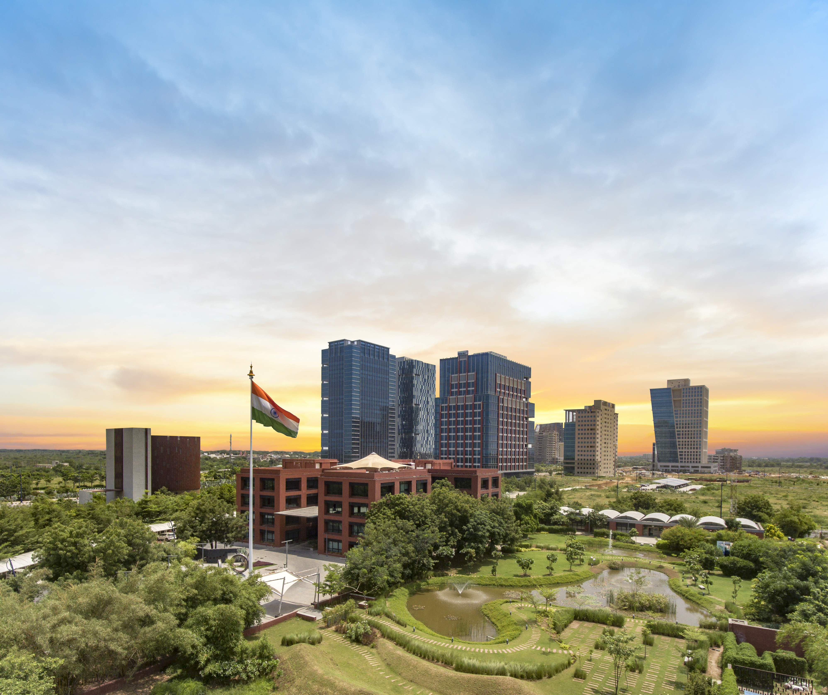
Competitive tax regime
1
Tax Holiday on Business Income for 10 out of 15 years
2
Minimum Alternate Tax* @ 9%
3
No CTT**/STT**/GST**/Stamp Duty
4
Reduced Withholding Tax of 9% on interest paid on Debt Instruments
5
Competitive Tax Regime for Funds
6
Incentives under Gujarat IT/ITeS Policy (2022-27)
*MAT provisions not applicable for companies opting for concessional tax rate under Sec. 115 BA of Income Tax Act, 1961
**CTT- Commodity Transaction Tax, STT- Securities Transaction Tax, GST- Goods and Service Tax
Notes:
GIFT City – Brief

Slide 9
Business Highlights: GIFT IFSC
1000 +
$ 82 Bn
$ 94 Bn
Number of Registrations granted by IFSCA August 2025
Monthly turnover on IFSC International Stock Exchanges in July 2025
Total Banking Asset Size in June 2025
186
$ 65 + Bn
$ 1365 Bn
Number of Funds Management Entities registered till July 2025
Cumulative Debt Listing on IFSC Exchanges till July 2025
Cumulative Banking transactions till June 2025
250 +
$ 71 Bn +
$ 27 Bn
Total targeted corpus of Alternative Investment Funds till July 2025
Aviation Assets leased from IFSC till July 2025
Derivative Transactions booked by banks in June 2025

Slide 10





































Key Entities in GIFT IFSC and GIFT City
Banking
Funds Industry
Service Provider
Other Entities
Firms in DTA

Slide 11
IFSC Business Verticals

Slide 12





















1. Banking sector
Banking Services in IFSC
18 Foreign Banks
Wholesale Banking
Corporate
Banking
Retail Banking
Trade
Finance
ECBs
ODI
17 Indian Banks
Acquisition Finance
Loan Syndication
Investments
Corporate Agent
Treasury Centres
Merchant Banking

Slide 13







2. Capital markets
Key Developments
NSE IFSC-SGX Connect Live:
Full Liquidity Switch: 3rd July 2023
Two Operational International Exchanges
1
Longer Trading Hours
No FX risk as trading in USD
Remote Trading Participants enabled
All time high open interest USD 20.84 Billion on September 24, 2024
Two Clearing Corporations
Direct Listing of Indian Stocks
2
One International Depository
Indian/Foreign Cos can list and raise foreign capital
IFSCA (Listing) Regulations, 2024 globally benchmarked
60,000 Demat Accounts opened

Slide 14
3. Funds Industry
VC Funds, Private Equity, Private Debt Funds, Hedge Funds, Sports Fund, Climate Funds, etc.
Targeted Corpus: $ 70 Bn
Invested into India and other Countries – USD 11.2 Bn
Three categories of FMEs
Registered FME (Retail)
Registered FME (Non-Retail)
Authorized FME
Key Global Investors
Sovereign Wealth funds/Pension funds (ADIA, GIC, Temasek, CPPIB, OTPP), Endowment Funds, IFC, Allianz, etc.
Entire ecosystem available
Trusteeship firms, Custodians, Fund Administrators, Law firms, Auditors etc.
VCC structure being enabled
PMS, Family Funds, Mutual Funds & ETFs

Slide 15























3A. Fund Ecosystem in IFSC
AIFs ( Venture Capital Funds, Private Equity Funds & Hedge Funds)
Portfolio Managers/Investment Advisors

Slide 16













4. Insurance and Re-insurance
IFSCA Insurance Offices (IIOs) are providing the following services:-
IFSC Insurance Offices (IIOs)
Direct Insurance-Life
Direct Insurance Non-Life
Direct
Insurance-Health
Re-Insurance
IFSC Insurance Intermediaries
Complete regulatory framework - Insurance Cos and Intermediaries
Regulations aligned to global standards
GIFT IFSC as a ‘Global Re-insurance Hub’

Slide 17

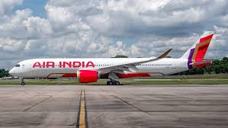




5. Aircraft leasing
Fastest Growing Market
Majority of fleet is on Lease
v
v
India is 3rd largest
domestic aviation market
75% of Indian fleet (~700 Aircrafts) are on operating lease from Ireland
One of Largest Orderbook
Forex Outflow as Lease Rentals
v
v
2000 aircrafts in next 10 years,
1600 + aircrafts ordered - US$ 100 Bn +
Airlines to pay USD 5 Bn per year for the next ten years towards lease rentals
GIFT IFSC ecosystem
Aircrafts leased from GIFT IFSC
Policy, regulatory and tax regime in place
33
250
Aircraft lessors
registered
Aircrafts/Helicopters/
Engines leased
Tata & Indigo have leasing arms

Slide 18

6. Fin-Tech & TechFin
Regulatory Cooperation
Fintechs & TechFins
FinTech Framework
2022
FinTech
Bridges
Inter-Operable Regulatory Sandbox with Domestic India Regulators (IoRS)
IFSCA-MAS (FinTech Bridge with Singapore)
Direct Authorization
Limited-Use Authorization
Categories of Grants
FinTech Startup Grant
Proof of Concept Grant
Green FinTech Grant
Listing Support Grants
FinTech
Incentives
Physical
Infra
FinTech Hub
Co-working spaces
Tie-ups with Incubators
Global FinTech Hub
Regulatory Cooperation
Investor
Eco-system
Infinity
Forum
Flagship Event to establish ‘Thought Leadership’
Hackathon Series I-Sprint-21 and I-Sprint-22
TechFin
Tieups with VCs
Tieups with Angels, Private Equity players.

Slide 19
7. Sustainable Finance
Bond and Credit Markets
USD 10 Tn needed to meet its
Net-Zero emission commitment by 2070
Globally aligned Regulation for ESG Debt Securities
Pre & Post Issuance Disclosures
International Sustainability Platform launched by NSE-IFSC
Banking
Mandatory board approved policy for Sustainable Lending
5 % loans directed towards Sustainable Lending
USD 3 Bn ESG Lending till date
Funds Industry
Sustainability related disclosures for large Fund Entities (AUM >$ 3 Bn)
Dedicated ESG Funds/Schemes enabled - Two ESG Fund
IFSCA Committee on Making IFSC a Climate Finance Hub

Slide 20

8. Indian International Bullion Exchange (IIBX)
Transparent, user-friendly, screen-based trading platform
Bullion is traded in the form of units of Bullion Depository Receipts (BDRs):
Promoters
NSE, INDIA INX, NSDL, CDSL and MCX
Products
Gold (995, 999) and Silver (Grain and Bars)
Gold Futures
Vaulting Capacity
Gold (420 Tonnes) and Silver (2200 Tonnes)
Qualified suppliers
Thirty-Three (33)
Qualified jewellers
One Seventy-Seven (167)
Bullion traded
100 + tonnes Gold
1148 Tonnes Silver
Key Opportunities for Global Firms
Become Bullion Suppliers on IIBX
Become Clearing & Trading Members on IIBX
Vaulting Infrastructure in IFSC
Gold Derivative launched

Slide 21




9. Foreign Universities
Foreign Universities can establish International Branch Campus (IBC)
Foreign Education Institution can establish Offshore Education Centre (OEC)
Live and upcoming universities at GIFT
Started in July 2024.
Courses Offered:
Master of Cyber Security
Master of Business Analytics
Complete Policy & Regulatory Ecosystem in Place
Globally aligned IFSCA (IBC & OEC) Regulations 2022
100% foreign ownership permitted
Complete freedom to repatriate profits
Free from Domestic Regulations (UGC & AICTE Acts disapplied)
Tax Incentive- 10 yrs tax holiday
Academic and administrative autonomy
Charge tuition fee in Dollars, Euro, AUD, etc.
No regulatory prescription on tuition fee
Permitted Courses- Management, Fintech & STEM
Started in Nov’ 2024
Courses Offered:
Masters of Fin-Tech
Expected to start in 2026
Courses Offering:
Masters in Artificial Intelligence
Masters in AI for Business
Expected to start in 2026
Courses Offered:
BSc Business and Finance
BSc International Business Management

Slide 22



10. Global in-house centres
USD 46 Bn
1580
1.66 Mn
65%
11.4%
GCC market size in FY
Number of GCCs in India
by 2023
GCC Headcount in India FY 23
GCCs in India have HQ in USA
CAGR between 2015 to 2023
Cost Advantage
Skilled Workforce
City & Infrastructure
Innovation ecosystem
10 Year Tax Holiday
Gujarat IT/ITeS policy: Capex and Opex Incentives
Revenue in AUD and expenses in Indian Rupee
India has a large talent pool of skilled professionals
Total enrolment in Higher Education: 43 Mn
10 Mn Graduates/year -
0.63 Mn graduates from Gujarat
GIFT City is a greenfield smart city
Best in class infrastructure
Vibrant and growing urban ecosystem
Robust Rail, Road, Air Connectivity
IFSCA GIC Regulations 2021: Regulated In-house Centre can offer differentiated services
Co-locating with Parent’s business operation.
BoA has set up 2200-seater GIC in GIFT IFSC

Slide 23
















11. Professional Services Providers & Accounting Services
2021
Ancillary Service Framework
Legal, Compliance and Secretarial
Professional & Management Consulting Services
Administration, Assets Management Support Services
2024
IFSCA (Bookkeeping, Accounting, Taxation & Financial Crimes Compliance Services) Regulation
Develop GIFT IFSC as a “Global Accounting and Taxation Hub”
Huge outsourcing opportunity
Talent and Cost advantage
Tax incentives
Regulated ecosystem

Slide 24



Thank You !
International Financial Services Centre Authority (IFSCA)
2nd and 3rd Floor, PRAGYA Tower, Block 15, Zone 1, Road 1C, GIFT SEZ, GIFT City, Gandhinagar,
Gujarat - 382355
+91-79-6180-9800
Info-desk@ifsca.gov.in
www.ifsca.gov.in

