Slide 1
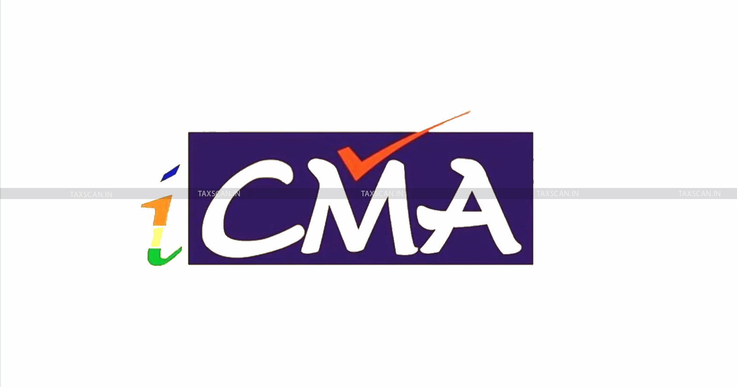

Initial Public Offering (IPO) Vs. Initial Coin Offering (ICO) CMA (Dr.) P. Siva Rama Prasad M.Com., MBA (Finance)., FCMA., FCS., FIIBF., FIII (Life & General)., MAIMA

Slide 2
Today’s Investors Demands
Low Cost Price of Acquisation of Investments.
Speed Delivery-If possible Instant-Online.
Hassel Free.
Quality of Investments.
High Returns.
Technology Oriented etc.
‘Technology Products’ most fulfills the above requirements of the Investors

Slide 3
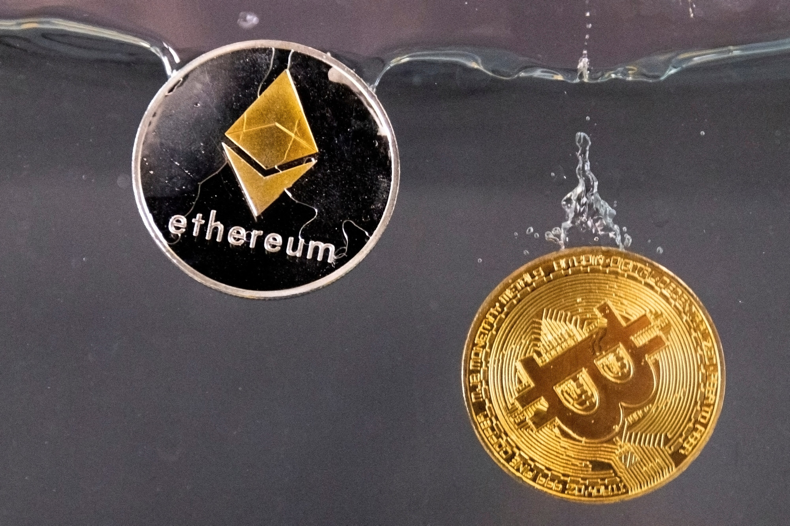
The Five Crypto Currencies
Mr. Trump, US President
Wants the US to Hold in “Government Reserves”

Slide 4
March 3, 2025 (Reuters)
U.S. President Donald Trump has Named Five Cryptocurrencies he wants to be part of a New Strategic Reserve-in other words, Crypto Holdings Owned by the U.S. Government.
XRP.
SOL.
ADA. All are Crypto Currencies.
Bitcoin.
Ether.

Slide 5
Components of India’s Forex Reserves
The Reserve Bank of India (RBI) manages India’s Foreign Exchange (Forex) Reserves, which are made up of:
Foreign Currency Assets,
Gold, and Our Country Reserves.
Special Drawing Rights (SDRs).

Slide 6
IPO Vs. ICO
An Initial Coin Offering (ICO) is a “Special Type of Fundraising” or “Capital Raising Activity” in the Cryptocurrency or Blockchain Environment.
It is used by Cryptocurrency Projects to Gather Capital to Fund the Development of a New Application, Service, or Crypto Coin. This Unregulated Crowdfunding Process is the Crypto Industry’s equivalent of an IPO.
ICOs are most suitable for MSMEs and Start-Ups.

Slide 7
IPO Vs. ICO
Synopsis
(Today’s Webinar)

Slide 8
IPO Vs. ICO
An Initial Public Offering (IPO) is a Stock Market Event, while an Initial Coin Offering (ICO) is a Cryptocurrency Event.
Both are ways for Companies to Raise Funds

Slide 9
IPO Vs. ICO
Initial Public Offering (IPO)
A Private Company sells its Shares to the Public for the First Time.
The Company transitions from Private to Public ownership.
An IPO can help Fund New Growth or Pay off Debt.
An IPO can take Months or Years.
The Securities Exchange Board of India (SEBI) monitors Public Companies.
An IPO involves legal, accounting, and marketing costs.
An IPO requires disclosure of financial and business information.

Slide 10
IPO Vs. ICO
Initial Coin Offering (ICO)
A Company sells new crypto to raise funds.
Investors receive cryptocurrency in exchange for their financial contributions.
ICOs are used to raise funds for products and services related to cryptocurrency.
ICOs can be used to bypass the capital-raising process required by venture capitalists or banks.
ICOs can attract all types of investors.
ICOs are unregulated means of raising money from public investors.
ICOs are also known as token sales.

Slide 11
Initial Public Offering-IPO
(Detailed Process)

Slide 12
Initial Public Offering-IPO
Companies typically go public to raise a huge amount of capital in exchange for securities.

Slide 13
Initial Public Offering-IPO
Raising capital: Companies primarily opt for an IPO to raise funds.
The funds raised through an IPO can provide the necessary resources for a company to fuel its growth plans and take advantage of new opportunities.

Slide 14
Initial Public Offering-IPO
Step 1: Hire an investment bank: A company seeks guidance from a team of underwriters or investment banks to start the process of IPO.
More often than not, they take services from more than one bank.
The study the company’s current financial situation, work with its assets and liabilities, and then they plan to cater to the financial needs.

Slide 15
Initial Public Offering-IPO
An underwriting agreement will be signed, which will have all the details of the deal, the amount that will be raised, and the securities that will be issued.
Though the under-writers assure on the capital they will raise, they will not shoulder all the risks involved in the money movement.

Slide 16
Initial Public Offering-IPO
Step 2: Prepare RHP and register with the SEBI: The Company and the underwriters, together, file the registration statement (mandatorily under the Companies Act) along with the Draft RHP (Red Herring Prospectus) which comprises of all the financial data, industry and business description, management details, probable price estimate per share, risk reports, business plans of the company and other disclosures as per the SEBI Act and Companies Act.
It will have to declare how the Company is going to utilize the funds it will raise from the IPO and about the securities of public investment.

Slide 17
Initial Public Offering-IPO
Step 2: Prepare RHP and register with the SEBI: The Company and the underwriters, together, file the registration statement (mandatorily under the Companies Act) along with the Draft RHP (Red Herring Prospectus) which comprises of all the financial data, industry and business description, management details, probable price estimate per share, risk reports, business plans of the company and other disclosures as per the SEBI Act and Companies Act.
It will have to declare how the Company is going to utilize the funds it will raise from the IPO and about the securities of public investment.

Slide 18
Initial Public Offering-IPO
These documents must be submitted to the Local ROC (Registrar of Companies) at least 3 days before the offer is opened to the public for bidding.
Then the company can make an application for the IPO to SEBI.
The initial prospectus is called so because the first page of the prospectus contains a warning which states that this is not a final prospectus.
However, all the obligations that the company’s prospectus will have, should also be contained in the RHP.

Slide 19
Initial Public Offering-IPO
Any variations between the two will have to be highlighted and be duly approved by SEBI and ROC.
If the registration statement is compliant with the stringent guidelines set by the SEBI, which ensures that the company has disclosed every detail a potential investor should know, then it gets a green signal.
Or else it is sent back with comments.

Slide 20
Initial Public Offering-IPO
The company should then work on the comments and file for registration again.
Only after the SEBI approves the application can the company set the date for the IPO.
Thereafter, the financial prospectus is released.
This phase also tests the waters for the IPO among the potential investors.

Slide 21
Initial Public Offering-IPO
Step 3: Application to Stock Exchange: The Company should decide on the stock exchange where it is going to list its shares and apply there.

Slide 22
Initial Public Offering-IPO
Step 4: Go on a roadshow: Before the IPO goes public, this phase happens over an action-packed two weeks.
The executives of the Company travel around the country marketing the upcoming IPO to potential investors, mostly QIBs in important financial centres.
The agenda of the marketing includes the presentation of facts and figures, which will drum up the most positive interest.

Slide 23
Initial Public Offering-IPO
At this stage of the IPO, the company may also give an opportunity to the bigger organizations to buy stocks of the company at a price set before the stock goes public.

Slide 24
Initial Public Offering-IPO
Step 5: IPO is priced: Based on whether the Company wants to float a Fixed Price IPO or Book Building Issue, the price or price band is fixed.
Fixed price method: The underwriter and company work together to fix a price for their shares.
The account of the liabilities, the target capital to be achieved, and the demands of stocks and every other related detail to come up with a price.

Slide 25
Initial Public Offering-IPO
Book building method: Here the underwriter and the company fix a price band within which the investors can bid.
The final price is dependent on the demand for the shares, the biddings received and the target capital to be achieved.
Except for infrastructure companies and banks, most companies are free to set their share price band.

Slide 26
Initial Public Offering-IPO
The Company is allowed to set the cap price at 20% higher than the floor price.
Books are normally open for 3 days during which bidders can revise their bids.
Issuers often prefer book-building as it allows better price discovery.
The final price of the issue is called the Cut-off Price.
The Company should also decide on the stock exchange where it is going to list its shares and apply there.

Slide 27
Initial Public Offering-IPO
Step 6: Available to the public: On a planned date, the application forms are made available to the public who can get a form from any designated bank or broker firms.
Once they fill in the details, they can submit them with a cheque, or online, as well.
SEBI has fixed the period of availability of an IPO to the public, which is usually 5 working days.

Slide 28
Initial Public Offering-IPO
When should the IPO reach the public – is a tricky decision.
Because picking the right time to offer shares is very imperative to maximize the earnings of sale.
Some companies have their own economic timeline to go public.
If the giant companies are scheduled to come into the market, smaller companies avoid their entry going public at the same time, fearing the stealing of the limelight by the giant companies.

Slide 29
Initial Public Offering-IPO
Once the IPO bidding is closed, the company has to submit the final prospectus to both ROC and SEBI.
This should contain both the quantum of shares being allotted and the final issue price on which the sale is closed.

Slide 30
Initial Public Offering-IPO
Step 7: Going through with the IPO: After the IPO price is finalized, the stakeholders and under-writers work together to decide how many shares each investor will receive.
Investors will usually get full securities unless they are oversubscribed.
The shares are credited to their demat account.
The refund is given if the shares are oversubscribed.
Once the securities are allotted, the stock market will start trading the Company’s IPO.

Slide 31
Initial Public Offering-IPO
Businesses must also ensure that its internal investors do not trade and thereby manipulate the stock prices of the IPO.
IPO shares are allotted to the bidders within 10 days of the last date of bidding.
If the IPO is oversubscribed, the shares are allotted proportionately to the applicants.
For example, if the oversubscription is five times the allotted number of shares.
Then an application for 10 lakh shares will be allotted only 2 lakh shares.

Slide 32
Initial Public Offering-IPO
The above are Certain Guidelines of Initial Public Offering
(Laborious Process)

Slide 33
Initial Coin Offering (ICO)
(Detailed Process)

Slide 34
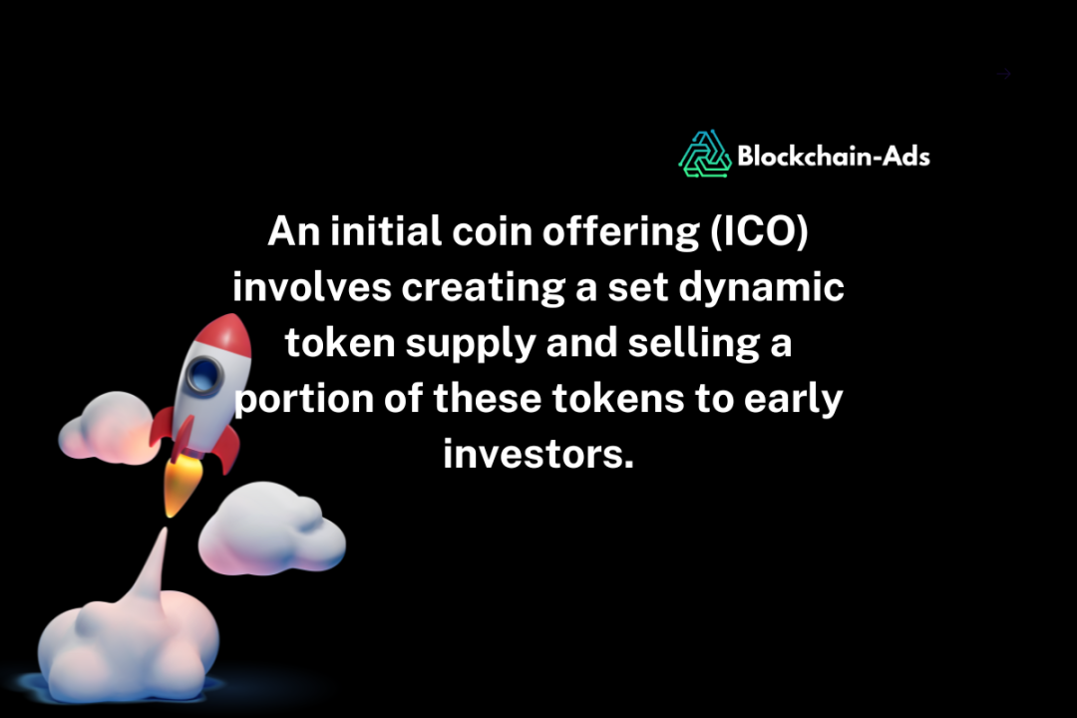
Initial Coin Offering (ICO)

Slide 35
Initial Coin Offering (ICO)
ICOs
Initial Coin Offering (ICO)
Defining the Coin Launch
How It Works
Examples
How to Launch

Slide 36
Initial Coin Offering (ICO)
As digital currencies and blockchain technology continue to advance, ICOs have become a popular method for startups to quickly and efficiently raise capital.
However, the lack of regulation has also paved the way for ICO scams, making it essential for potential investors.

Slide 37
Initial Coin Offering (ICO)
An initial coin offering (ICO) is a method used by cryptocurrency projects to raise capital.
It involves creating a set dynamic token supply and selling a portion of these tokens to early investors.
It as the crypto industry’s version of an Initial Public Offering (IPO).

Slide 38
Initial Coin Offering (ICO)
An ICO allows startups to bypass traditional fundraising methods and directly reach potential investors globally.
However, it's important to approach ICOs with caution, as fewer than half of them succeed, and the risk of scams is quite high.

Slide 39
Initial Coin Offering (ICO)
Companies looking to launch a new cryptocurrency, app, or service can use an ICO to fund their development.
During an ICO, these Companies sell Virtual Tokens to Investors.
These tokens can serve various purposes, such as granting access to a specific service or representing a stake in the project.

Slide 40
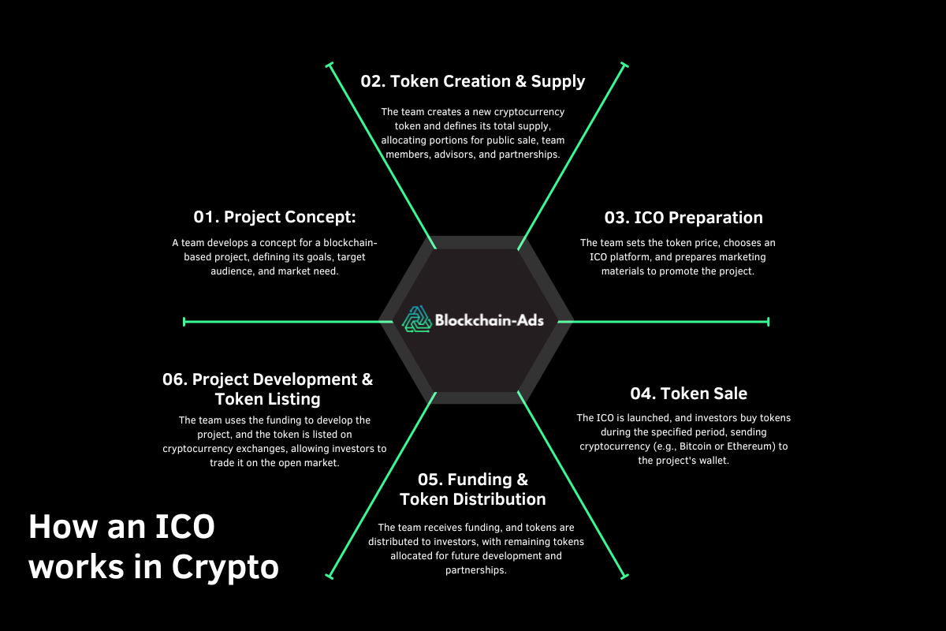
Initial Coin Offering (ICO)

Slide 41
Initial Coin Offering (ICO)
The process of an initial coin offering (ICO) starts with a cryptocurrency project looking to raise capital.
Now, the team behind the project drafts a detailed plan, often called a whitepaper, outlining the project's goals, the amount of money needed, the number of tokens to be issued, and how long the ICO campaign will run.

Slide 42
Initial Coin Offering (ICO)
ICOs can be structured in various ways, primarily revolving around the concepts of token supply and pricing.
Static Supply/Static Price: In this model, the total token supply is fixed, and each token is sold at a set price.
For example, a project might issue one million tokens at $1 each.
The goal is clear and straightforward: Once the tokens are sold out, the ICO ends.

Slide 43
Initial Coin Offering (ICO)
Static Supply/Dynamic Price: Here, the total token supply is fixed, but the price varies depending on the amount of capital raised.
If a project has one million tokens and raises $2 million, each token's price will be adjusted accordingly.
This structure allows for flexibility in pricing based on demand during the ICO.

Slide 44
Initial Coin Offering (ICO)
Dynamic Supply/Static Price: In this case, the token price is fixed, but the total token supply can fluctuate based on the funds raised.
For instance, a token might be priced at $0.50, and the number of tokens issued will depend on how much capital is collected by the end of the ICO campaign.

Slide 45
Initial Coin Offering (ICO)
During the ICO process, the cryptocurrency project team promotes the ICO calendar to make sure that potential investors know when and how to participate.
Investors typically buy the tokens using established cryptocurrencies such as Bitcoin or Ethereum.

Slide 46
Initial Coin Offering (ICO)
A crucial aspect to consider in the tokenomics of an ICO is how the tokens are distributed and used.
A well-structured tokenomics plan ensures transparency and builds trust with investors.
It shows how the total token supply will be allocated among the team, investors, and future project needs.

Slide 47
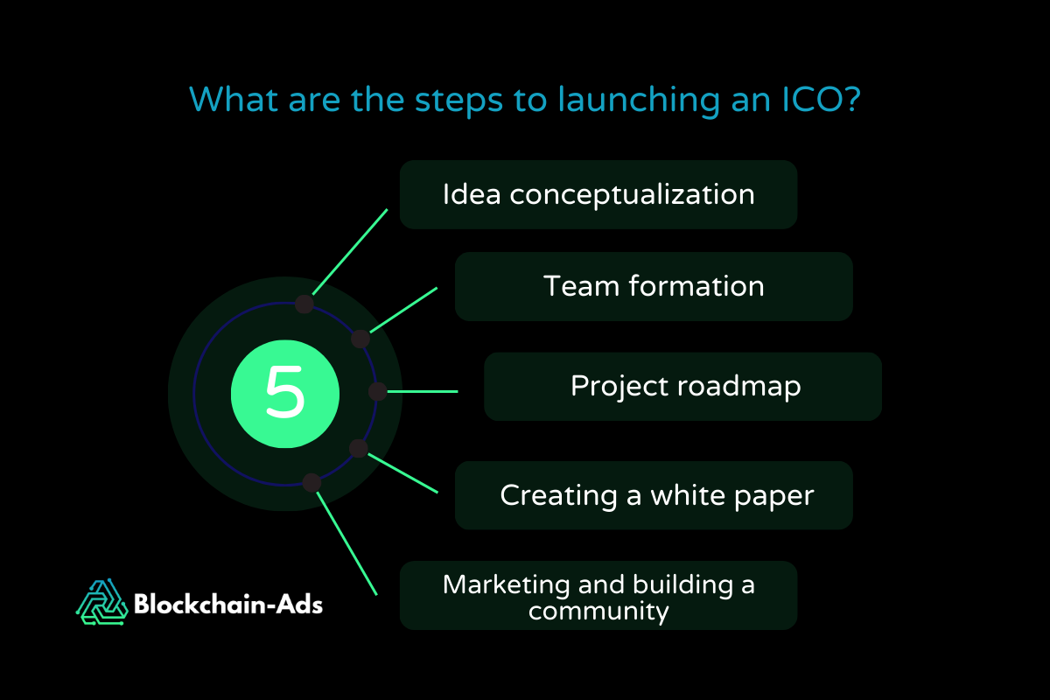
Initial Coin Offering (ICO)

Slide 48
Initial Coin Offering (ICO)
Launching a successful ICO involves several key steps:
Idea conceptualization: The first step is having a clear, innovative idea.
This idea should address a specific problem or need in the market.
It’s important to outline what makes project unique and how it will benefit users.

Slide 49
Initial Coin Offering (ICO)
Team formation: Assemble a team of experts who can bring the project to life.
This team typically includes blockchain developers, marketers, legal advisors, and business strategists.
A well-rounded team can provide the necessary skills and credibility to attract investors.

Slide 50
Initial Coin Offering (ICO)
Project roadmap: Create a detailed project roadmap that outlines the development stages, milestones, and timelines.
This roadmap should provide a clear vision of where the project is headed and how it will achieve its goals.

Slide 51
Initial Coin Offering (ICO)
Creating a white paper: One of the most crucial steps is to release a white paper.
This document should provide an in-depth explanation of the project, including its purpose, technology, team, tokenomics, and how the funds will be used.
A well-crafted white paper can enhance investor confidence and interest.

Slide 52
Initial Coin Offering (ICO)
Marketing and building a community: Effective marketing is important for a successful ICO.
Use social media, forums, and other online platforms to create hype and buzz around the project.
Engaging with the community, answering questions, and providing regular updates can build a loyal following and attract more investors.

Slide 53
Initial Coin Offering (ICO)
Anyone with a solid idea and a basic understanding of blockchain technology can launch an initial coin offering (ICO).
Unlike traditional fundraising methods, there are no stringent requirements or lengthy processes.
This open accessibility is part of what makes ICOs so appealing to new cryptocurrency projects.

Slide 54
Initial Coin Offering (ICO)
However, the ease of launching an ICO comes with responsibilities.
Regulatory considerations are crucial.
While ICOs often operate in a less regulated space than initial public offerings (IPOs), they are not entirely free from oversight.
The Securities and Exchange Commission has cracked down on ICOs that violate securities law.
This means it's important to comply with all relevant regulations to avoid legal issues.

Slide 55
Initial Coin Offering (ICO)
Credibility and transparency are also vital.
Investors want to know that their money is in safe hands.
Conducting thorough background checks on developers and team members can help establish trust.
This includes verifying their previous work, ensuring they have a clean track record, and demonstrating their expertise in the field.
Building this credibility can make or break the success of an ICO.

Slide 56
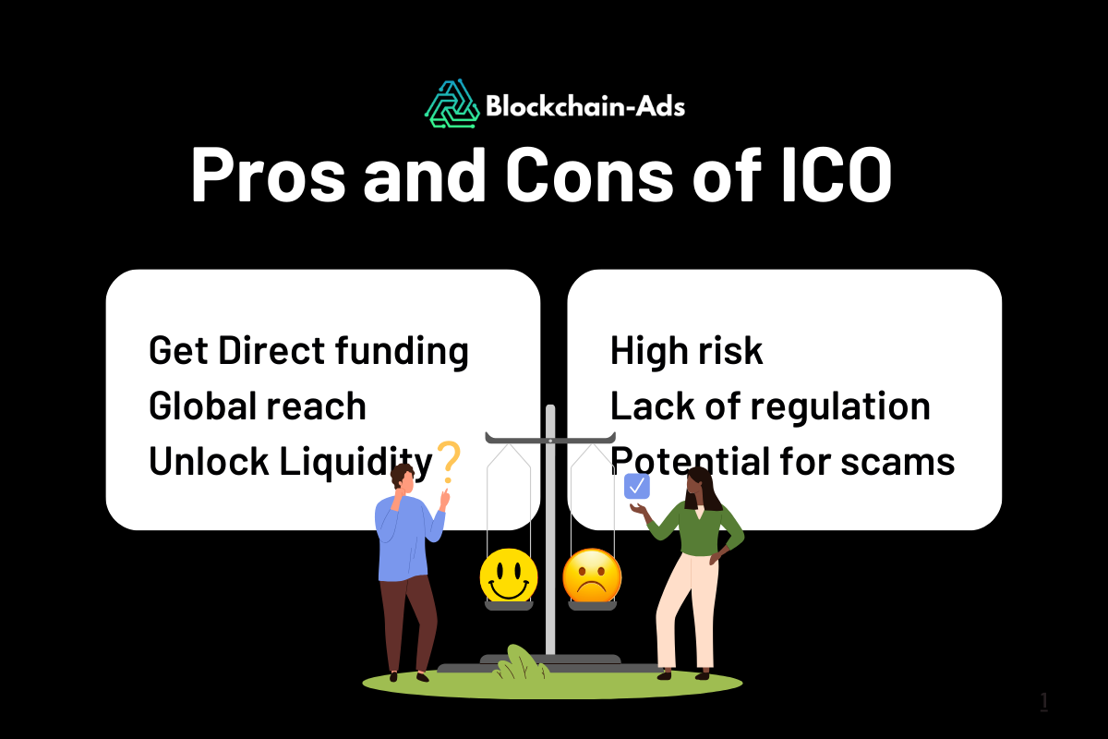
Initial Coin Offering (ICO)

Slide 57
Initial Coin Offering (ICO)
Initial coin offerings offer several benefits that make them an attractive option for raising funds. Here are the benefits of ICOs:
Direct funding: ICOs allow projects to raise capital directly from investors without the need for intermediaries such as banks or venture capitalists.
This direct approach can simplify the fundraising process and reduce costs.

Slide 58
Initial Coin Offering (ICO)
Global reach: Next, ICOs can attract investors from all over the world.
This global reach increases the potential pool of investors and can lead to more substantial funding.

Slide 59
Initial Coin Offering (ICO)
Liquidity: Lastly, tokens issued during an ICO can often be traded on cryptocurrency exchanges shortly after the ICO ends.
This liquidity provides investors with the ability to quickly buy and sell tokens, which makes ICOs an attractive option.

Slide 60
Initial Coin Offering (ICO)
An initial public offering (IPO) is heavily regulated by financial authorities such as the Securities and Exchange Commission.
This ensures that companies provide detailed financial disclosures and adhere to strict compliance standards.
In contrast, initial coin offerings (ICOs) operate in a more relaxed regulatory environment, often with less oversight, which can lead to a higher risk of fraud and scams.

Slide 61
Initial Coin Offering (ICO)
Investor protections also differ between the two.
IPO investors receive shares of the company, granting them equity and a level of legal protection.
ICO investors typically receive utility-related tokens, which may not offer the same protections and can vary in value based on the success of the cryptocurrency project.

Slide 62
Initial Coin Offering (ICO)
Fundraising with initial coin offerings has been a popular method for cryptocurrency projects to raise funds, leading to both successes and failures.

Slide 63
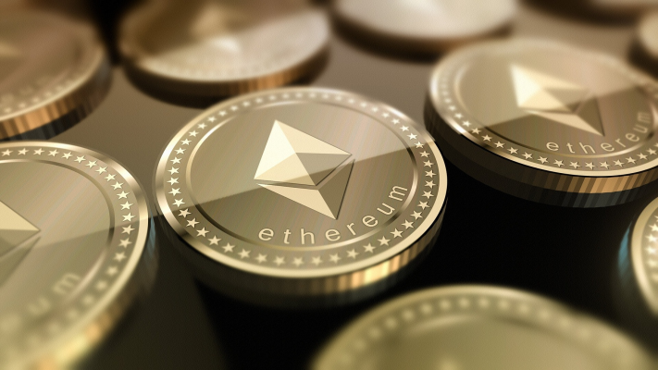
Initial Coin Offering (ICO)
Some Examples
Ethereum:

Slide 64
Initial Coin Offering (ICO)
Launched in July 2014, Ethereum's ICO is one of the most well-known.
It raised $18.4 million, and it introduced the concept of a programmable blockchain to the crypto world.
This innovation allowed developers to create decentralized applications (dApps) on the Ethereum network.
Ethereum's success is evident as it has grown to become the second-largest cryptocurrency by market capitalization, only behind Bitcoin.

Slide 65
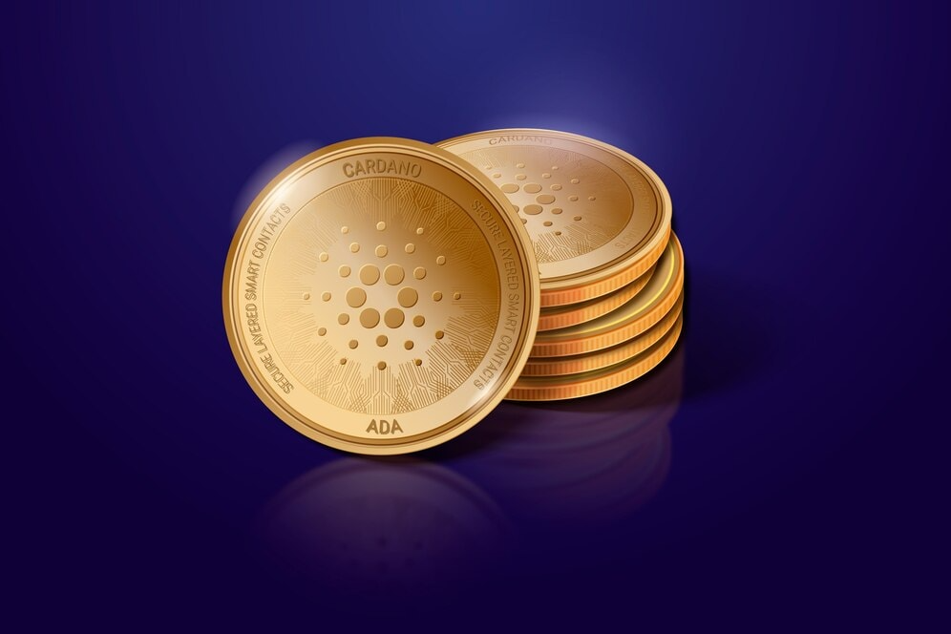
Initial Coin Offering (ICO)
Cardano:

Slide 66
Initial Coin Offering (ICO)
Cardano's ICO took place in January 2017 and was another major success.
It raised $62.2 million and aimed to improve on the technological foundations laid by Ethereum.
Moreover, Cardano focused on creating a more secure and scalable blockchain.
Its natural token, ADA (Adenosine Deaminase), has since become a top-five cryptocurrency by market capitalization.

Slide 67
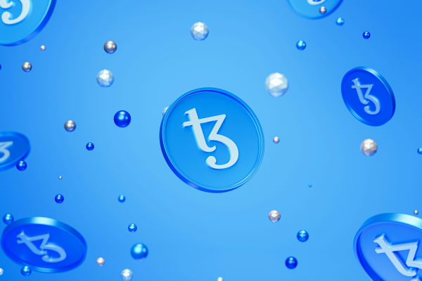
Initial Coin Offering (ICO)
Tezos:

Slide 68
Initial Coin Offering (ICO)
Tezos held its ICO in July 2017, and it raised a substantial $232 million.
However, it wasn't without its challenges.
The project faced numerous delays in distributing tokens and legal issues, culminating in a $25 million settlement.
Despite these hurdles, Tezos has managed to establish itself in the crypto space, showing resilience and the ability to overcome early setbacks.

Slide 69
Initial Coin Offering (ICO)
ICO Regulations in Developed Countries
Many ICOs are security offerings and need to be registered.
Rule 504 of Regulation D allows companies to sell up to $10 million in securities in a 12-month period.

Slide 70
Initial Coin Offering (ICO)
To Conclude
This is most suitable for MSMEs and Start-Ups due to the following:
Democratization of Capital Markets: ICOs do not require intermediaries like banks and stock exchanges.
Global Capital Access: ICOs also ensure that blockchain startups can access a global network of investors, extending their sources of finance beyond regional borders.
Liquidity: Because tokens generated during initial coin offerings (ICOs) are frequently tradeable on cryptocurrency exchanges, investors have more options when it comes to buying or selling.

Slide 71
Initial Coin Offering (ICO)
To Conclude
This is most suitable for MSMEs and Start-Ups due to the following:
Potential for Higher Returns: Because of the potential for rapid growth and lower initial token prices, early investors in successful initial coin offerings (ICOs) might profit handsomely.
Faster Fundraising and Greater Potential for More Funds: The amount of money that can be raised is far greater than that of other fintech models (such as crowdsourcing) and occasionally even more than that of traditional IPOs, in part because of the increased interest in crypto assets.

Slide 72
Initial Coin Offering (ICO)
To Conclude
For MSME Corporates / Start-up Companies in India, requires Technology related IPOs due to the following reasons:
To Quick Start of the Companies.
Least Cost in Mobilization of Funds through IPOs.
Trading / Investment on Technology preferred by Young Investors etc.

Slide 73
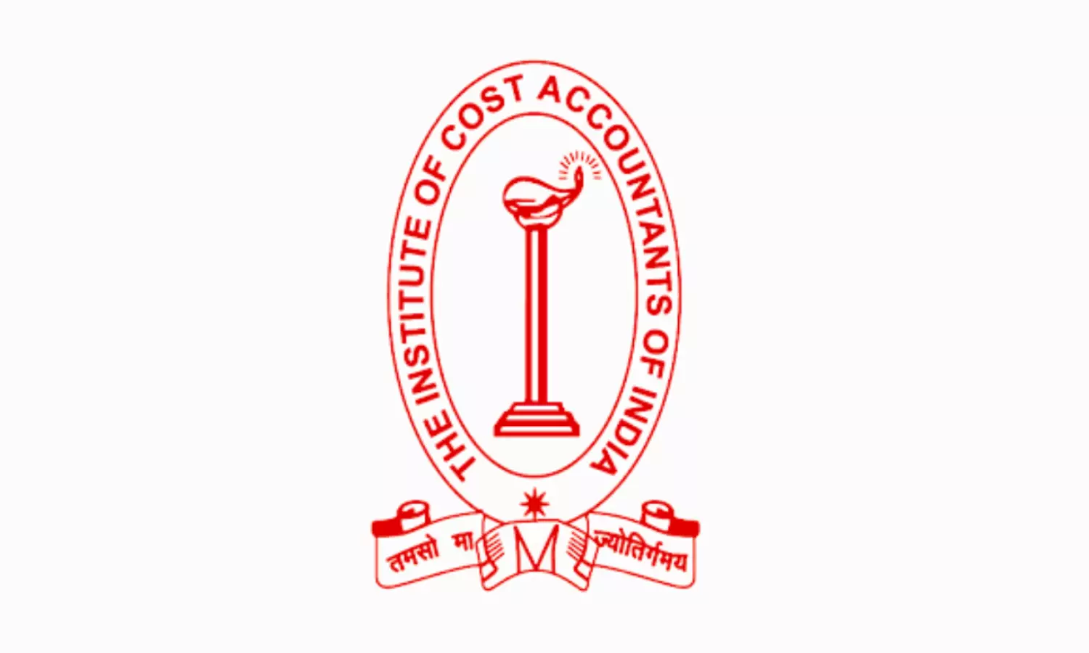
Thank You
CMA (Dr.) P. Siva Rama Prasad
Asst. General Manager (Retd.)
State Bank of India
Hyderabad
M.Com., MBA (Finance)., FCMA., FCS., FIIBF., FIII (Life & General)., MAIMA.,

