Slide 1
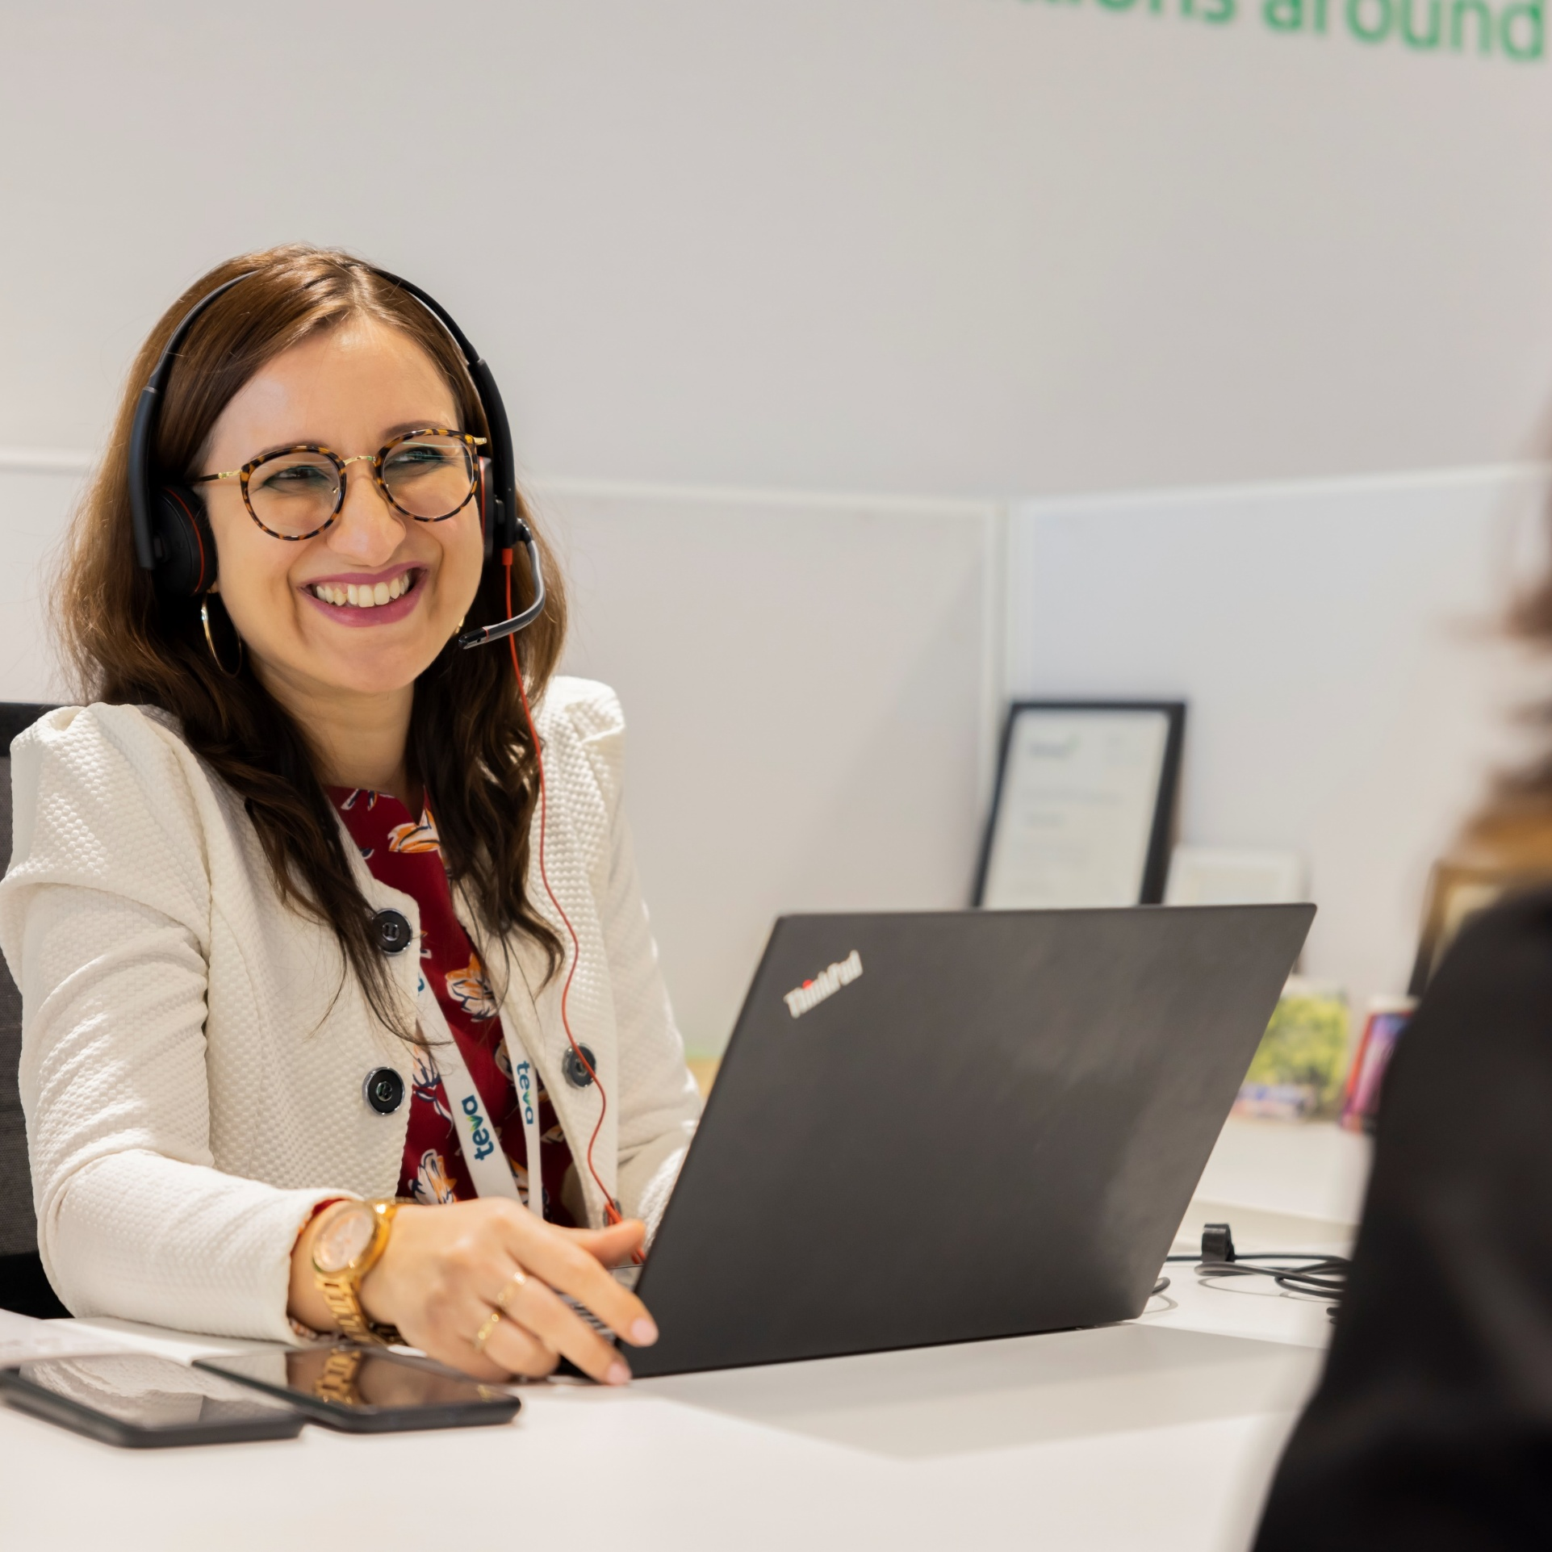



Campus Interviews Hiring Financial Analysts and Cost Analysts in GBS Finance We are looking for ICWA/CMA Qualified CTC Range: 8 lacs onward (Basis Experience)
Make an Impact, make it yours.
Tuesday, 25th Nov 2025 AND Wednesday , 26th Nov
ICWA Campus – Walk-in
The Rialto Hotel 20/21 Seshadri Road, Bengaluru,
Karnataka 560009
https://www.google.com/maps/place/The+Rialto+Hotel/@12.9801186,77.5768114,16.54z/data=!4m9!3m8!1s0x…
Notes:
ICWA or MBA finance

